Slide 1
GCBASIC
PIC16F175xx
Part 13 - Using a SPI GLCD display solutions

Slide 2

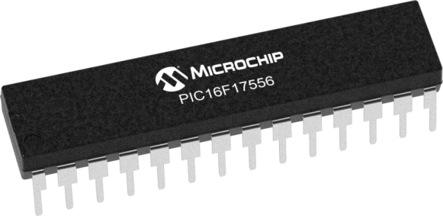
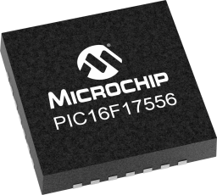
GCBASIC
PIC16F175xx
Part 13 - Using a SPI GLCD display solutions

Slide 3
GCBASIC
Like and subscribe!

Slide 4
PIC16F175xx
PIC16165xx is a high performance PIC16
Digital and analog peripherals for flexible embedded control
10-bit ADC for accurate analog signal conversion
Multiple communication interfaces including UART (serial), I²C, and SPI
PWM modules with CCP and 16-bit resolution for precise timing and motor control
Configurable Logic Cells (CLCs) for custom hardware-level logic without external components
Integrated op amps for onboard analog signal conditioning and amplification
The PIC16175xx offers 14, 20, 28, 40 and 44-pin products in small footprint packages to support customers in a wide variety of applications.

Slide 5
Videos...
Install the hardware and make the board work – three LED programs
Make four LEDs flash in a sequence
Set the LEDs to represent the value of ADC
Sequence the LEDs with a delay using the value of ADC
Using an input to set the state of the LEDs
Using the reset switch
Using the switch, ADC – make the LEDs flash in a sequence with reverse
Using the serial to display values
Using the timer0 overflow, 8bit timer, 16bit timer to flash the LEDs
Using EEProm – showing values on the serial terminal, and more constants insights
Using I2C with serial to discover I2C devices
Using I2C GCLD display solutions
Using a SPI GLCD display solutions
Using PWM, many ways, to dim the LEDS
Using an external interrupt to control an LED
Using storage within the chip – Progmem, SAF memory, EEPROM and DATA blocks
Using CLC
The GCBASIC tool chain
Assembly , alternatives assemblers and MPLAB-X
Summary

Slide 6
GCBASIC Compiler
GCBASIC Compiler
GCBASIC is an Open Source compiler for PIC , AVR and LGT microcontrollers
GCBASIC now supports the 16F175xx chip family

Slide 7
Prerequisites
Assumes you have
Installed the GCBASIC software
Installed your programmer software
Test that you have the 16F175xx attached
You have the 4 LEDs operating
You have a POT connected
You have SWITCHes connected
You have a USB/TTL converter
GLCD SPI device

Slide 8
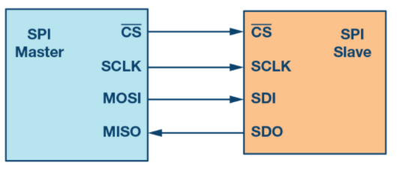
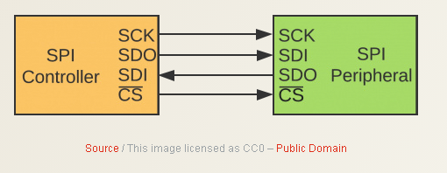
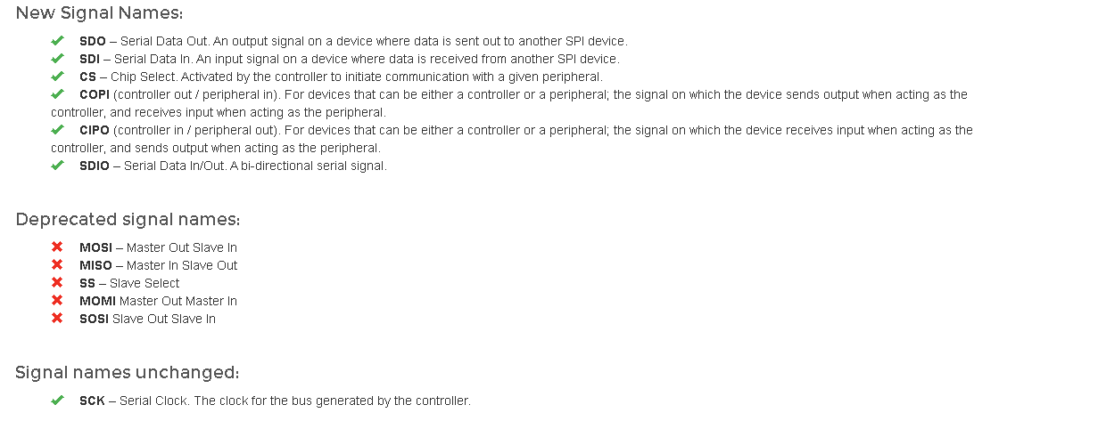
SPI
Serial Peripheral Interface (SPI) is an interface bus commonly used to send data between microcontrollers and small peripherals such as GLCD, shift registers, sensors, and SD cards.
It uses separate clock and data lines, along with a select line to choose the device you wish to control.

Slide 9
Hardware
Hardware
-------------------PORTA----------------
Bit#: -7---6---5---4---3---2---1---0---
IO: ----------------SW----------ADC--
----------------------------------------
-------------------PORTB----------------
Bit#: -7---6---5---4---3---2---1---0---
IO: ---------------------------------
----------------------------------------
------------------PORTC-----------------
Bit#: -7---6---5---4---3---2---1---0---
IO: ----TX1-SDO-SCK-----RST--CS--DC—
-----------------------------------------
------------------PORTE-----------------
Bit#: -----------------3---------------
IO: ----------------MCLR--------------
Prototype Board
Power 5v0
Programmer
LEDs & resistors
Switches & resistors
SPI device and circuit

Slide 10
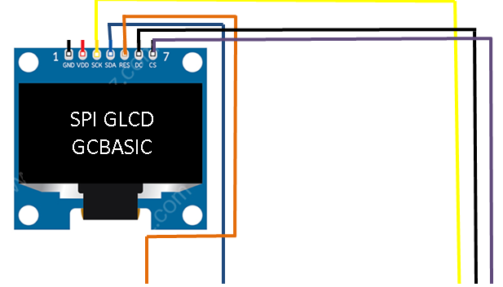
Setup - Connections

Slide 11
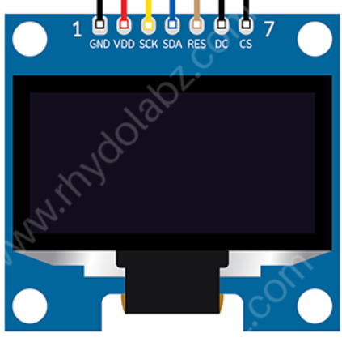
Setup - Program
SPI GLCD
GCBASIC
DATA
This is a PPS chip, so, needs to make the PPS match these assignments
/* Pin mappings for GLCD data and clock
#DEFINE GLCD_DO portC.5
#DEFINE GLCD_SCK portC.4
/* Pin mappings for GLCD support
#DEFINE GLCD_DC portC.0
#DEFINE GLCD_CS portC.1
#DEFINE GLCD_RESET portC.2 #DEFINE SSD1331_HardwareSPI

Slide 12
Setup – when things do not work ..
Things do not always work
The more connections the more trouble
Things we know
The GLCD demonstration works
Therefore is not likely to be the libraries but … work through the checklist first
Checklist
Check your connections, twice
Write a program to pulse a signal on each line, each line on at a time
Always use the software SPI first to prove connectivity
Then, use PPS/hardware SPI is #3 works

Slide 13
Lab
Review setup and operation of a SPI GLCD
Software SPI – bit banging
Harware SPI – with PPS ( of course)
Conditional compilation

Slide 15
Videos...
Install the hardware and make the board work – three LED programs
Make four LEDs flash in a sequence
Set the LEDs to represent the value of ADC
Sequence the LEDs with a delay using the value of ADC
Using an input to set the state of the LEDs
Using the reset switch
Using the switch, ADC – make the LEDs flash in a sequence with reverse
Using the serial to display values
Using the timer0 overflow, 8bit timer, 16bit timer to flash the LEDs
Using EEProm – showing values on the serial terminal, and more constants insights
Using I2C with serial to discover I2C devices
Using I2C GCLD display solutions
Using a SPI GLCD display solutions
Using PWM, many ways, to dim the LEDS
Using an external interrupt to control an LED
Using storage within the chip – Progmem, SAF memory, EEPROM and DATA blocks
Using CLC
The GCBASIC tool chain
Assembly , alternatives assemblers and MPLAB-X
Summary

Slide 16
GCBASIC
PIC16F175xx
Part 13 - Using a SPI GLCD display solutions

